Slide 1
HConverter: An LLVM based Binary Translator for HSAIL

Slide 2
前後對照--
clang
p2h
.cl
PTX
Hsail
clang
llvm-IR
Hsail backend
brig
cl2hsail
X86-native

Slide 3
Hsaemu—architecture

Slide 4

HSA emulator framework
Guest OS
Application
agent
Brig file
runtime
swi handler
PQEMU
VCPU thread (ARM)
VGPU thread
Monitor thread
signal
TCG
Code cache
Code cache
translator
CU thread
Host OS

Slide 5
Translator
Current framework
  HConvert : Interface between translator and QEMU
  HDecoder: Translate HSA Brig to LLVM IR
  HAssembler : Generate a object file from LLVM IR
libHSAConvert.a
.brig
HConvert
.config
HSAIL
HDecoder
.object
IR
HAssembler
LLVM
pqemu
Code cache
loader
Notes:
確認流程…..

Slide 6
Overall flow – Monitor & CU thread
Collect information from guest
  Duplicate brig into local cache(host addr space)
1. initial
  Block itself again to wait for a new job.
Initialize the monitor threads when booting.
  Wake up all CU thread to execute and block itself.
  Prepare for the code cache(include MMU)
  Call the translator and deliver the brig cache.
  Call the linkloader to produce the real code cache from the .o output of the translator
CU thread
  Wake up by the CU thread and reset all the environment.
Monitor thread
4. Wake up
4. block
6. block
5. Wake up
3. call
4. execution
translator
.object
linkloader
Code cache
3. deliver
3. produce
3. translate
arg
brig
HVA
2. Duplicate
2. Duplicate
arg
brig
GVA

Slide 7
HSA Translator
.cl to hsail
© Copyright Khronos Group, 2013

Slide 8
Using clang
clang+libclc
ptx2hsail
Hsail
.cl
PTX
1.Instrction mapping
2.String tranlation
We can use the libclc library, written by Peter Collingbourne, to provide the OpenCL built-in functions for Clang. This library will map OpenCL built-in functions to target-specific functions in the LLVM IR that the PTX back-end knows how to handle.

Slide 9


ptx2hsail
Concept:
 | Platform PTX | Platform Hsail
Instruction A
Instruction B | selp | Step1: Step2: Step3:

Slide 10
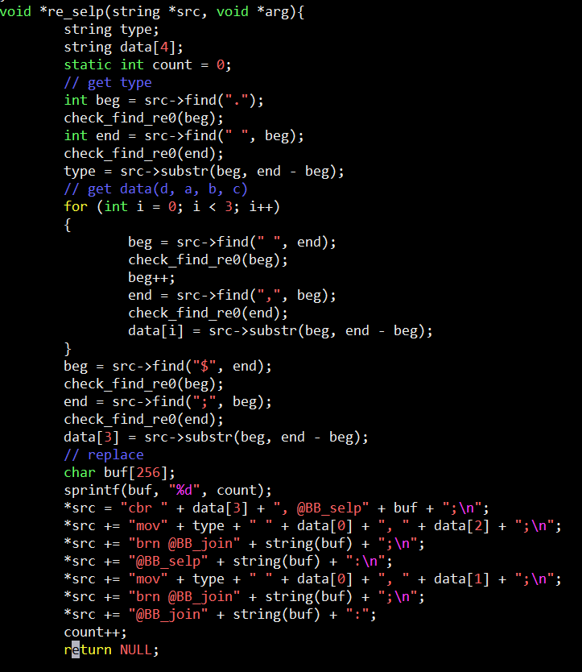
Implementation of selp

Slide 11
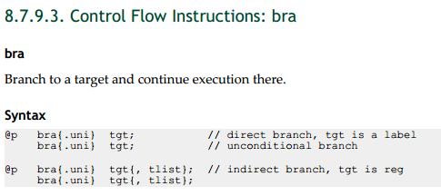
ptx

Slide 12
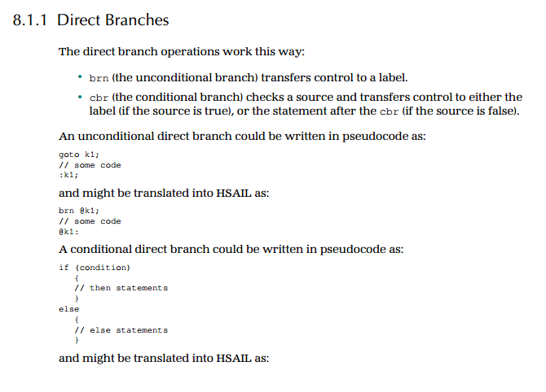
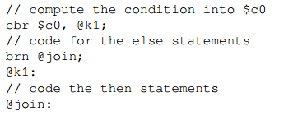
hsail

Slide 13
HSA Translator
HSAIL to x86 Convertor
© Copyright Khronos Group, 2013

Slide 14
HSA Translator
HSAIL(brig) LLVM IR x86
  Brig is the HSAIL binary format.
  In our emulator, brig is Kernel code.
LLVM lib
link
HSA Translator
HSAIL
(brig)
HSA Decoder
LLVM
Optimizer
HSA
Assembler
X86
object file
LLVM IR
LLVM IR
HSA Decoder translates brig file to LLVM IR, and HSA Assembler translates LLVM IR to x86 binary file.

Slide 15
HSA Translator
HSAIL(brig) LLVM IR
LLVM lib
link
HSA Translator
HSAIL
(brig)
HSA Decoder
LLVM
Optimizer
HSA
Assembler
X86
object file
LLVM IR
LLVM IR
HSA Decoder decode the brig file and maps HSAIL instructions to LLVM IR.

Slide 16
HSA Translator
LLVM IR x86
LLVM lib
link
HSA Translator
HSAIL
(brig)
HSA Decoder
LLVM
Optimizer
HSA
Assembler
X86
object file
LLVM IR
LLVM IR
HSA Assembler translates LLVM IR to x86 machine code.
HSA Assembler includes LLVM code generator(backend).

Slide 17
HSA Translator
LLVM IR x86
LLVM lib
link
HSA Translator
HSAIL
(brig)
HSA Decoder
LLVM
Optimizer
HSA
Assembler
X86
object file
LLVM IR
LLVM IR
LLVM code generator(backend) splits the code generation problem into individual passes—instruction selection, register allocation, scheduling, code layout optimization, and assembly emission—and provides many built-in phases that are run by default.

Slide 18
Linker Loader and Helper Function
Linker Loader
X86
object file
Linker &
Loader
Code cache
Helper
function
(memory relative instruction, GPU Kernel information instruction…etc)
In HSAIL, there are some instructions which LLVM IR is not support. We use helper functions to simulate the instructions.
After linking, object codes load in code cache and wait for executing.

Slide 19
Backend-llvm
Code Generation Process

Slide 20
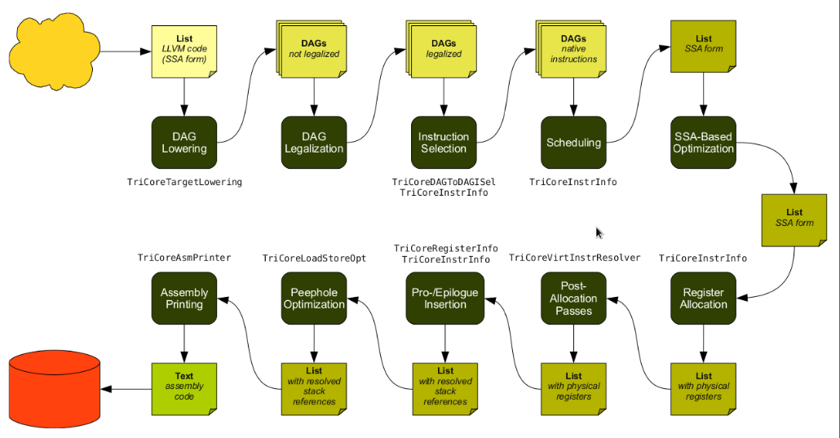
Code Generation Process
Notes:
Ssa-based optimization
Peephole optimization

Slide 21
Instruction Selection
Backend流程的第一步，將LLVM IR 轉換成一組SelectionDAG(有向無環圖)，每一node代表一個LLVM instruction.
任2指令definition-use relation 由using node -> defining node 之edge表示
如有control flow dependency =>額外的edge
由於不保證支援目標指令提供的type&op，必須先把前述DAG做legalization 再由instruction selector 建立以目標指令的DAG
LLVM instruction的DAG=>透過instruction selector=>目標機器指令的DAG

Slide 22
Scheduling and Formation
上ㄧ步的目標指令DAG會在這裡轉成目標指令list
以llvm::MachineFunction, llvm::MachineBasicBlock, llvm::MachineInstr三種class表示function, 之中的基本區塊, 指令
Scheduler 必須決定以何種順序將目標指令寫出(受到許多因素如control flow等等影響)
此時的指令還是SSA form
依舊使用LLVM virtual register set
虛擬堆疊空間，還未計算為真正的offset

Slide 23
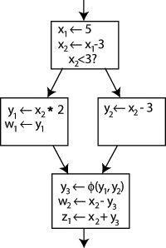
Register Allocation
將LLVM virtual register 轉換成對應的目標機器實體暫存器
LLVM會對每一virtual register 配置 physical register, 如超過數量LLVM做split code選擇某些register內容搬至memory
SSA form產生的phi function由copy指令取代

Slide 24
Prologue/Epilogue Code Insertion
經過上ㄧ步register allocation後，此時可計算每一函式需要多少stack space
之前virtual stack的指令可以存取到對應的sp(top),fp(bottom)的offset
可對各函式的出入口寫相對應的prologue 和epilogue
Notes:
Prologue push stack
Epilogue pop

Slide 25
Code Emission
做目標機器代碼生成
Static: 寫入檔案
JIT:寫入memory

Slide 26
cl2hsail
© Copyright Khronos Group, 2013

Slide 27
cl2hsail
clang
p2h
.cl
PTX
Hsail
cl2hsail
clang
llvm-IR
Hsail-backend

Slide 28
Implemetation

Slide 29
instruction without support
There are some instruction without llvm IR supporting for hsail:
Barrier
Atomic
GroupID
.
.
.

Slide 30
Example:
Pseudo code
llvm-IR
Load
arg a1
call barrier(a1)
store
int reduction()
{
barrier();
}
Call barrier();

Slide 31
Example:
.cl
llvm-IR
Lowercall()
{
}
int reduction()
{
barrier();
}
Call brrier();
HsailISD::Barrier0
Barrier();

Slide 32
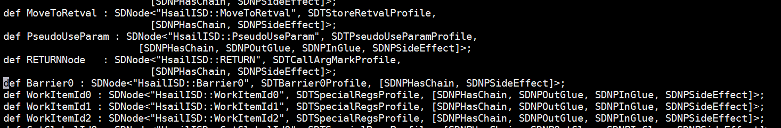
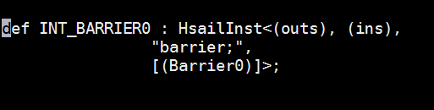
HsailInstrInfo.td

Slide 33
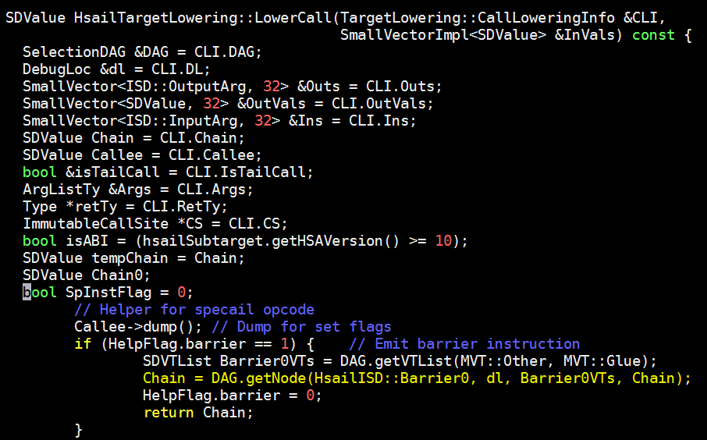
HsailISelLowering.cpp

Slide 34
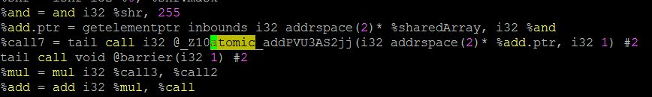
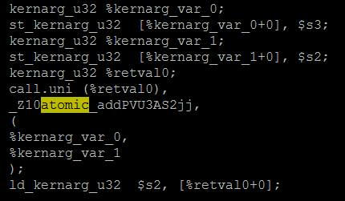
Non-Mask function-call
File: .ll
.hsail
Notes:
Hsail 有提供這個指令，但是沒有mask的話會生成device funciton call

Slide 35
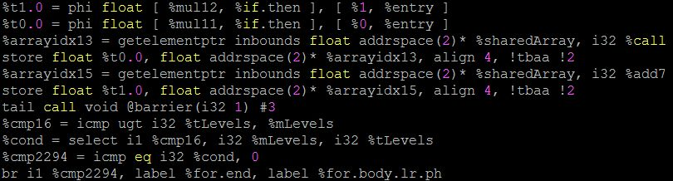
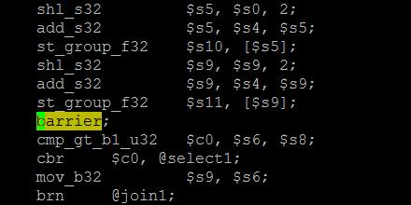
Mask function call
File: .ll
.hsail

Slide 36
Q&A

